Slide 1
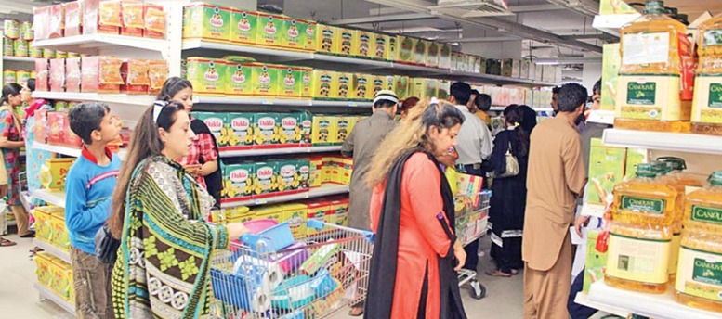
SUPERMARKET SALES ANALYSIS
MEMBERS:
Ismail Ahmed Ansari (20K-0228)
Insha Samnani (20K-0247)
Yusra Adam (20K-0207)
Abdullah Memon (20K-0283)
DUE DATE: 29TH April,2022
COURSE TITLE: PROBABILITY AND STATISTICS
(MT-0205)
Figure 1: Super Market

Slide 2
ABSTRACT
Revenue and sales market in business is considered
a key element for growth, measures are taken to avoid
unnecessary, and steps are taken to do the things
repeatedly done in D2C and B2B businesses, to increase
the valuation amounts. As queues in supermarkets seem
to be inevitable, we try to find solutions that can improve
and speed up the checkout process.

Slide 3
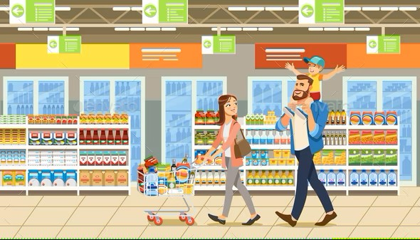
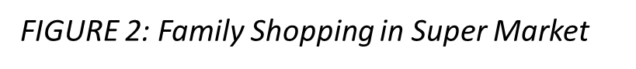
CONT..
This, however, requires access to real-world data
for developing and validating models. With this
objective in mind, we have prepared and used
publicly available high-frequency dataset of a
supermarket containing nearly 3 months of actual
transactions, ins and outs from a grocery supermarket
belonging to one of the major Myanmar retail chains.

Slide 4

RESEARCH OBJECTIVE/QUESTION
HOW DIFFERENT FACTORS CONTRIBUTES TO HIGHER SALES
IN A PARTICULAR SUPER MARKET OF A
PARTICULAR CITY?
FIGURE 3: Question Mark

Slide 5
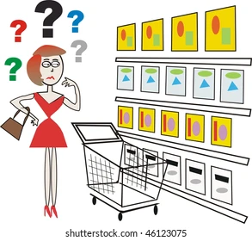
WHY THIS QUESTION WOULD BE INTERESTING?
Research regarding various factors affecting higher sales
could also help to create products that provide
solutions, market to consumers effectively, and increase
your chances for success.
Retail research helps in the process of critical
self-evaluation and lets retailers look at the
services provided by them to customers in
the market.
It also provides brief foresight of the market
to the company.
FIGURE 4: Confused Woman Shopper

Slide 6
REFERENCES OF LATEST ARTICLES ASSOCIATED WITH OUR OBJECTIVE
1- https://www.vendhq.com/blog/how-to-increase-sales-retail/ (March 22, 2022)
2- https://www.investopedia.com/ask/answers/042815/which- economicfactors-most-affect-demand-consumer-goods.asp (March 17, 2022)
3- https://www.gofrugal.com/blog/10-ways-to-boost-sales-in-your supermarket/ (March 19, 2021)
4- https://saspjournals.com/wp-content/uploads/2018/05/SJEBM-54- 286-294-c.pdf (April 30, 2018)
5- https://www.sba.gov/blog/10-ways-get-new-customers (April 07, 2017)

Slide 7
SOURCE OF OUR DATASET
https://www.kaggle.com/datasets/aungpyaeap/supermarket-sales

Slide 8

DATA COLLECTION METHODOLOGY
The growth of supermarkets in most populated
cities are increasing.
In addition, market competitions are also high.
This dataset is one of the historical
sales of supermarket company.
It is recorded in 3 different branches of
“Mustafa Center” located in Mandalay,
Naypyidaw, Yangon belonging to country
“Myanmar” and consist their 3 months data
(2016, April-June).
FIGURE: Types of Data Collection Methodology

Slide 9
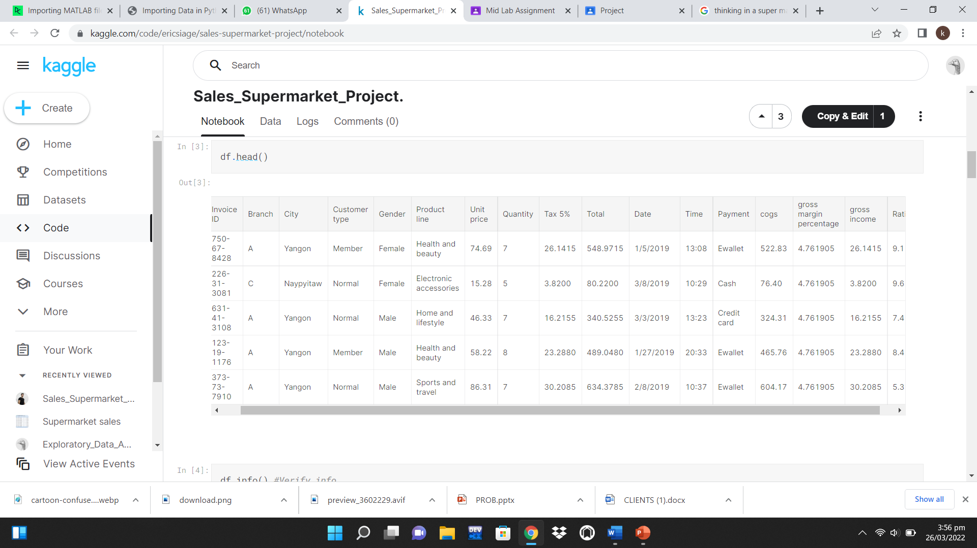
VIEW OF OUR DATASET

Slide 10
VARIABLE NAMES
INVOICE ID:
Invoice ID, also called an invoice number is
a computer-generated number that is assigned
to each unique individual who does shop from
a certain supermarket.
Invoice numbers are important because it helps
businesses to keep track of not just whether payments
have been made but also by whom.
In our dataset, we have tracked invoice ID of each
customer in order to maintain record.

Slide 11
CONT..
BRANCHES:
In our dataset, branches refers to a supermarket’s
different stores at different locations.
Maintaining from which branch customer has
made purchase.
In our dataset, we have three branches (A,B,C).

Slide 12
CONT..
CITY:
Branches of a supermarket might be in same
city or in different cities.
We have three branches located in different cities
(Yangon, Naypyitaw, Mandalay) maintained in our dataset.

Slide 13
CONT..
CUSTOMER:
Another variable in our dataset that specifies the
type of customer, whether they are availing membership
card or are normal customers.
Member card serves as an identification and is used
by customers to avail benefits and discounts.
Normal customers don't have any member card and
does normal purchase.

Slide 14
CONT..
GENDER:
Gender of the customer: male or female.
Which item was bought by which gender to
keep track of the products being purchased by
male or female.

Slide 15
CONT..
PRODUCT LINE:
Product line is a group of connected products
marketed under a single brand name by the same
company.
Product lines are created by companies as a marketing
strategy to capture the sales of consumers.
Categorization of items into electronic accessories,
beauty products, health products, food and grocery,
sports, travel and many more.

Slide 16
CONT..
UNIT PRICE:
The price for a single unit of measure of a product
sold in more or less than the single unit.
If quantity and total price is known, simply divide
the total price by quantity to find the unit price.
Unit price may vary depending on the size of the
product, help you to save money by comparing the
cost of the same item in different sized containers
or different brands.

Slide 17
CONT..
QUANTITY:
Quantity in our dataset, represents the number of
purchases made by a customer.
An important variable to further proceed with the
billing for the products of a customer.

Slide 18
CONT..
TAX:
Tax is basically amount of money that a person
needs to pay on public expenditures based on his
income.
Imposing tax on products purchased by every
customer.
In our data, we have assigned a tax of 5% on
products purchased by customers.

Slide 19
CONT..
TOTAL:
The variable total specifies the total amount of
the product after including tax as well.
Total is calculated by multiplying unit price with
the quantity and adding the 5% tax in it.

Slide 20
CONT..
DATE:
Date variable talks about the date on which the
product was purchased by the customer.
Important to maintain in case if a customer wants to
return that product or checking for the warranty period.
TIME:
Time tells at which time the product was bought by
the customer.

Slide 21
CONT..
PAYMENT:
Payment variable specifies the mode of payment
of customer that could either be through cash or
credit card.
Variety of payment options opens door for more
customers as it is feasible for them.
In our data set, we have mentioned only three
modes cash, credit card and E-wallet.

Slide 22
CONT..
COST OF GOODS SOLD (COGS):
COGS is the direct cost of producing the goods
sold by a company or services offered by the company.
COGS includes the cost of material and labor
directly used to create the goods.
COGS excludes costs such as overheads, marketing
and advertising expenses.

Slide 23
CONT..
GROSS MARGIN PERCENTAGE:
Gross margin is the amount of money a company
retains after incurring the direct costs for producing
goods and services provided by the company.
Amount of money made before deducting selling,
general and administrative costs.
Gross margin can be calculated by subtracting net
sales and COGS.

Slide 24
CONT..
GROSS INCOME:
Gross income is individual's total earnings
before taxes or other deductions.
This income includes income from all sources
not just limited to employment also include property,
pensions and rental income.
Gross income for business is total revenues minus
COGS.

Slide 25
CONT..
RATINGS:
How much a customer is satisfied or dis-satisfied
by the services.
Customer can rate their experiences on a scale of
1 to 10, 1 being highest and 10 being lowest.
This customer ratings can help the company to improve
their customer services or the areas of improvements.

Slide 26
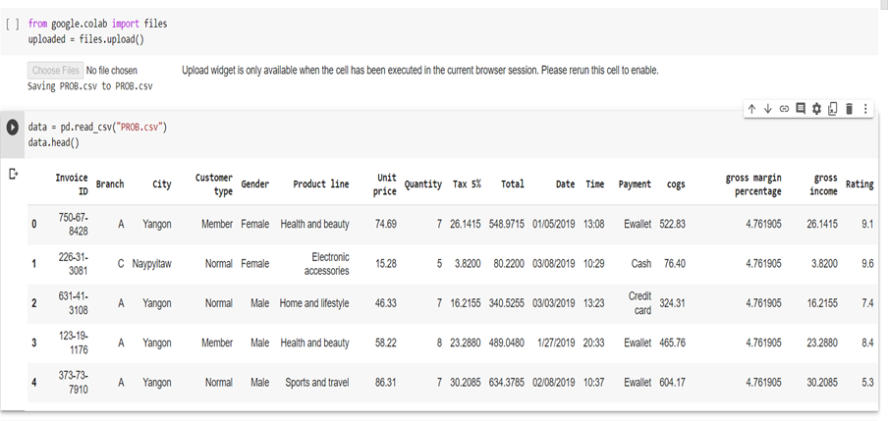
READING AND UPLOADING DATA

Slide 27
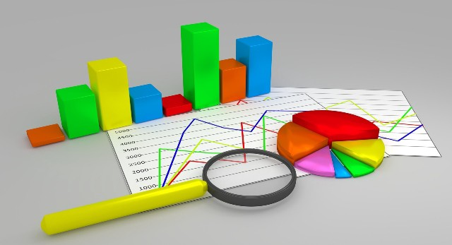
TYPES OF ANALYSIS USED
STATISTICAL ANALYSIS:
Pie Chart
Bar Chart
Histogram
Count Plot
Displot
FIGURE 5: Types of Statistical Analysis

Slide 28
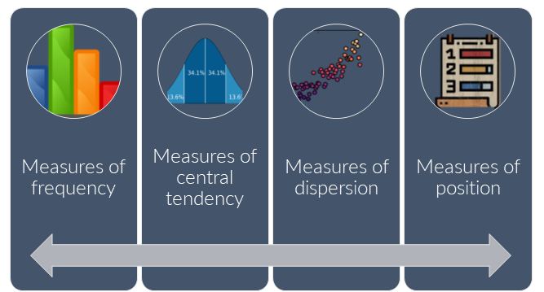
CONT…
DESCRIPTIVE ANALYSIS:
Mean
Groupby
Arrange
FIGURE 6: Types of Descriptive Analysis

Slide 29
WHY WE USED THESE ANALYSIS?
PIE CHART:
Pie charts are mostly used to represent
categorical and nominal data.
Pie chart displays data in a circular graph
and each circular piece is proportional to
the fraction of the whole in each category.
Pie charts are useful in displaying qualitative
results used in research to highlight factors
individually to look upon what affects
their sales or success rates.

Slide 30
CONT..
BAR CHART:
Bar charts are a useful way used in researches
and scientific reports as an informational graphics.
It is used to create visual presentations of
quantifiable data variables.
Bar charts help in organizing large data
sets based on numerical values.

Slide 31
CONT..
HISTOGRAM:
Histogram displays the distribution of values in
a data series and provides visual representation
of data distribution.
In research it is used as a graphical representation
that organizes a group of data points into
user-specified ranges.
Helps in pointing out outliers, skewness and
bimodality form a data set of research.

Slide 32
CONT..
COUNTPLOT:
Count plot method of analysis is used
to show the counts of observations in
each categorical bin using bars.
DISTRIBUTION PLOT:
Distribution plot is used to represent the
variation in the data distribution.

Slide 33
CONT..
MEAN:
Mean represents the central location of distribution
of random variables.
Mean is an important measure because it
incorporates the score from every subject in
the research study.
GROUPBY:
It analyzes the data set as whole and
gives underlying relationships among variables.

Slide 34
CONT..
Extracts statistics from large data sets and
separates data based on identic ability.
ARRANGE:
Arranging the data helps in easy and
accurate visualization.
Because of different outcomes it is needed
to arrange the data.

Slide 35

SOFTWARE USED
Google Collab (Online Python Compiler)
FIGURE 6.1: Google Colab Logo

Slide 36
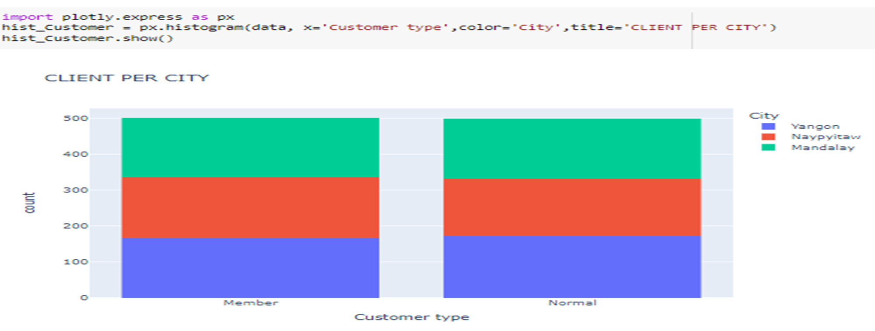
GRAPHS AND TABLES SHOWING THE RESULTS
FACTOR 1: CLIENTS:
VISUALIZATION OF CLIENT PER CITY:
The graph shows that how much MEMBERS and NORMAL
CUSTOMERS are there in a city out of three. Normal
customers being inspired by services, referral codes, discount
offers, promotes expertise’s to others that further attract
new clients. On the other hand, member customers shops
on daily basis, increasing the profit of a particular branch.
FIGURE 7: Visualization of Client Per City

Slide 37
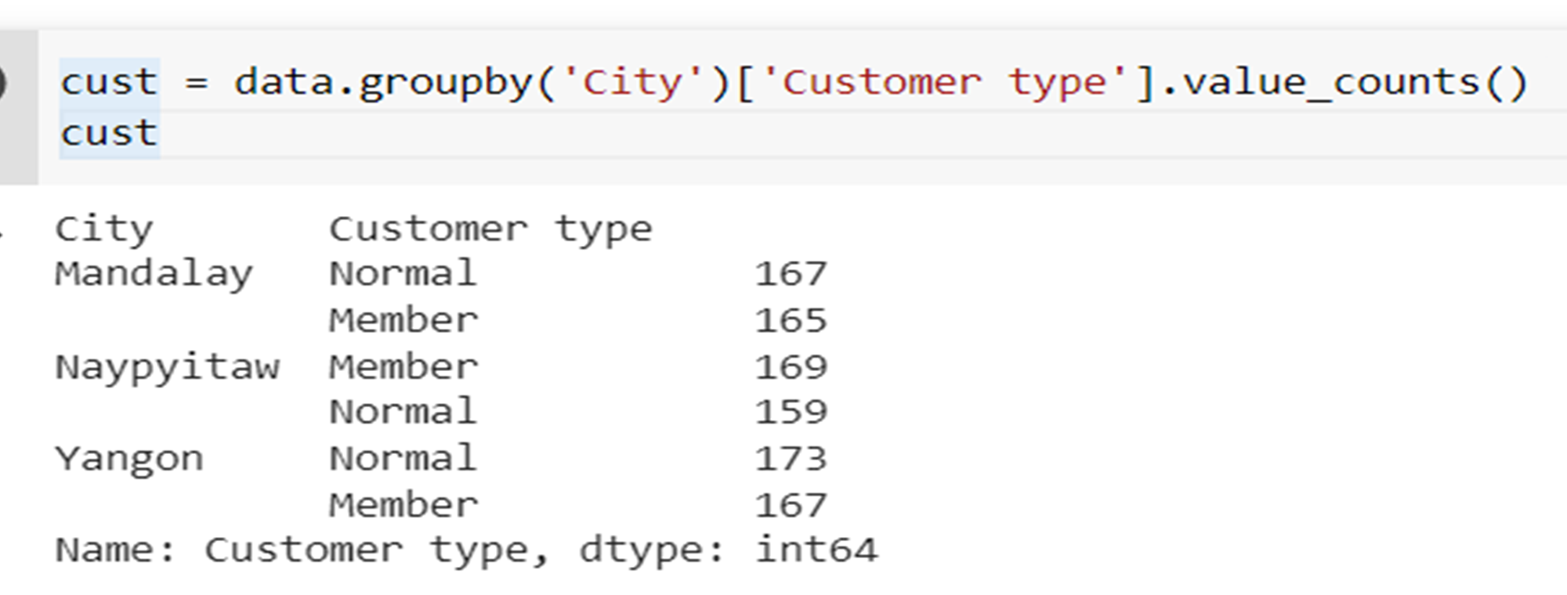
FACTOR 1 CONT..
TYPES OF CLIENTS PER CITY:
It is very important to know that what is the ratio of
NORMAL CUSTOMERS and MEMBERS. It must be noticed
that NORMAL CUSTOMERS in each city are more as compared
to MEMBERS. However, their ratio is almost equal. As when
Normal customers gets introduced to a market so the services,
referral codes, and discount offers introduce them as a member
time by time that increases the sales of that market. This means
that Yangon, in future will have more sales as compared to other
two cities.
FIGURE 8:Types of Client Per City

Slide 38
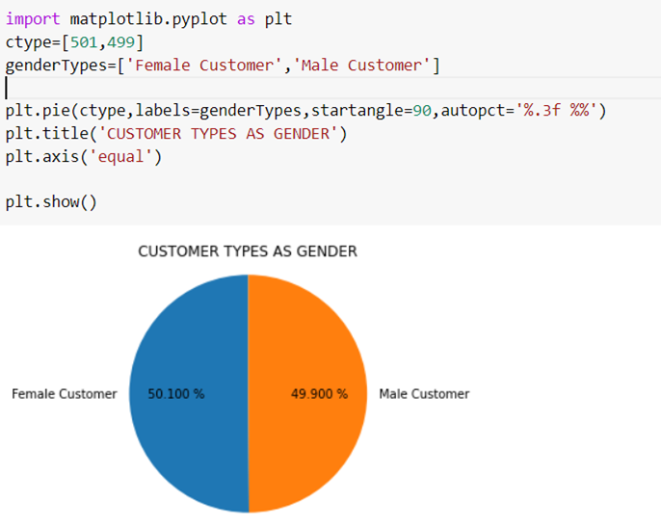
FACTOR 1 CONT..
GENDER WISE CLASSIFICATION:
It must be noted that MALE and FEMALE approach
shopping with different motives, perspectives, rationales,
and considerations. Research have found that females shops
using visual imagery and interpreting context. While males
use logical computations and processing facts. Females
shopping motives tend to be hedonic, and it is utilitarian
in case of males.
FIGURE 9: Gender Wise Classification

Slide 39
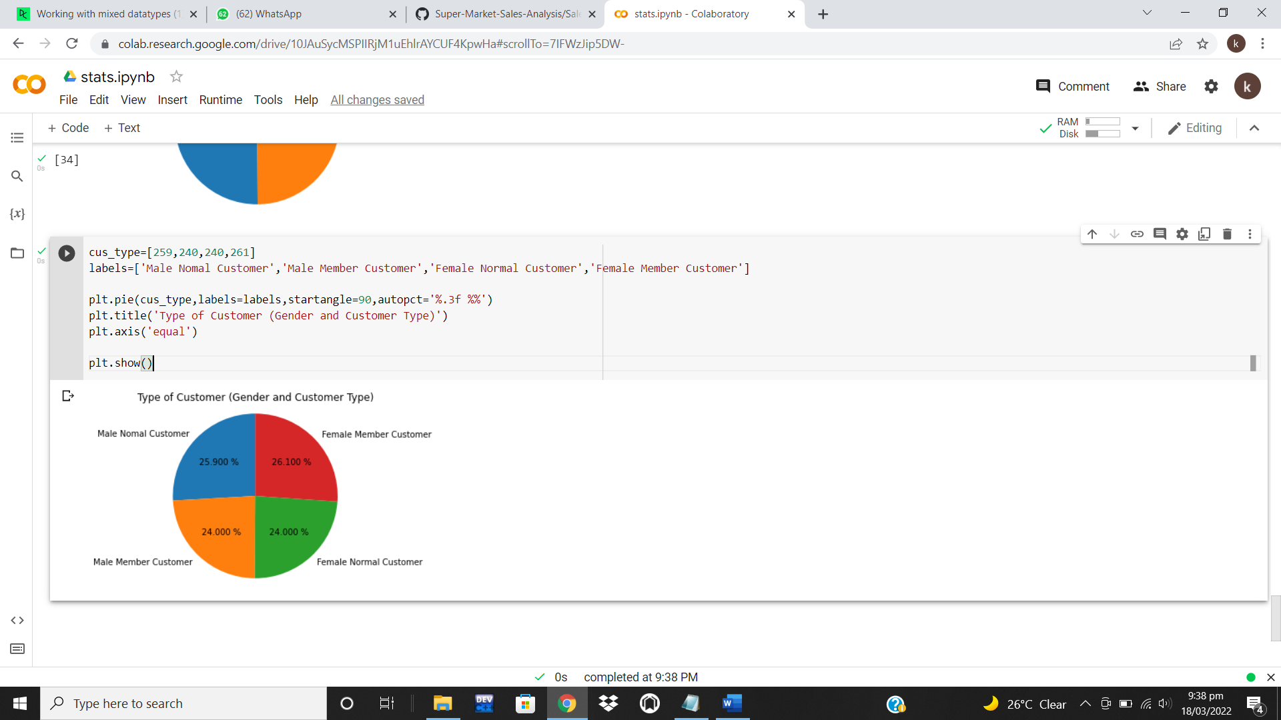
CONT..
This means that females shops more as they
buy essential things along with those things
that are not necessary, but they love them.
Overall, in three cities, the ratio of females
and males are almost equal resulting in
balanced increase of sales in all the cities.
FIGURE 9.1: Gender Wise Classification

Slide 40
FACTOR 1 CONT..
GENDER VS PAYMENT METHODS:
Different payment methods increases conversions and
develops market trust and loyalty. To reach the largest
portion of the market possible, local payment methods
that are convenient to customers must be introduced.
If not provided, so here is the highest possibility that
they may never return.

Slide 41
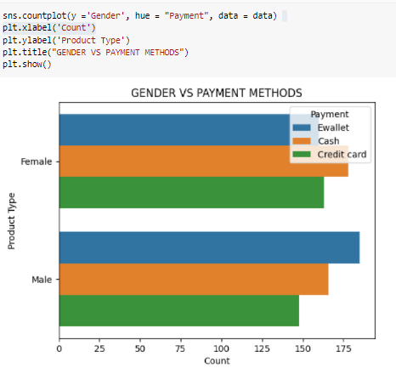
CONT..
As upper-class people usually prefer to use
e-wallets and credit cards and on the other
hand middle and lower-class people prefer to
pay through cash. And all three payment methods
are used equally by males and females, so
availability of required payment methods make
it easy for the clients to shop that further increases sales.
FIGURE 10: Gender VS Payment Methods

Slide 42
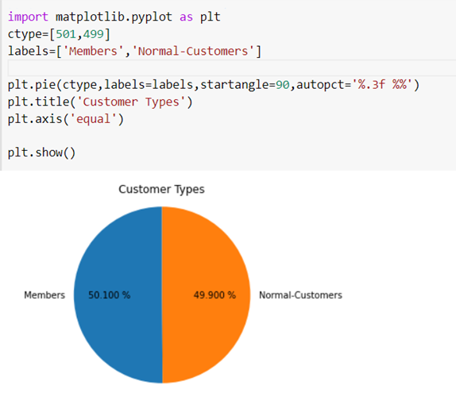
FACTOR 1 CONT..
OTHER VISUALIZATION:
As described that how NORMAL CUSTOMERS and
MEMBERS are important for increasing the sales in
a particular market so here is the visualization of
overall cities that their ratio appears almost same
as both types of customers are shopping and interchanging
their roles simultaneously.
FIGURE 11: Other Visualizations

Slide 43
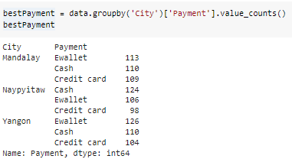
GRAPHS AND TABLES SHOWING THE RESULTS
FACTOR 2: MODES OF PAYMENT:
BEST MODE OF PAYMENT PER CITY:
The receiving channel allows the customers to
make the payments without any difficulty and for
ease and their comfort, modes of payments are
introduced, it also helps supermarket owners to
finance the payments. The values show the evenly
equal distributed modes of payments for each branch
across 3 different cities.
FIGURE 12: Best Mode of Payment Per City

Slide 44
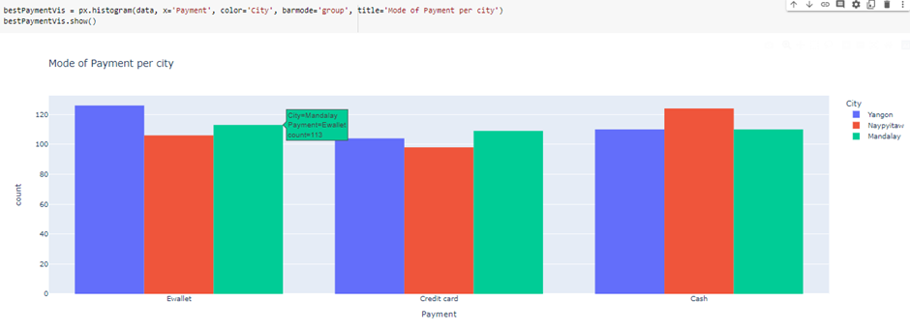
FACTOR 2 CONT..
VISUALIZATION OF BEST MODE OF PAYMENT
PER CITY:
The statistical model, also elaborated that the
customers pay the amount in equal fashion of
modes of payments in all the branches.
FIGURE 13: Visualization of Figure 12

Slide 45
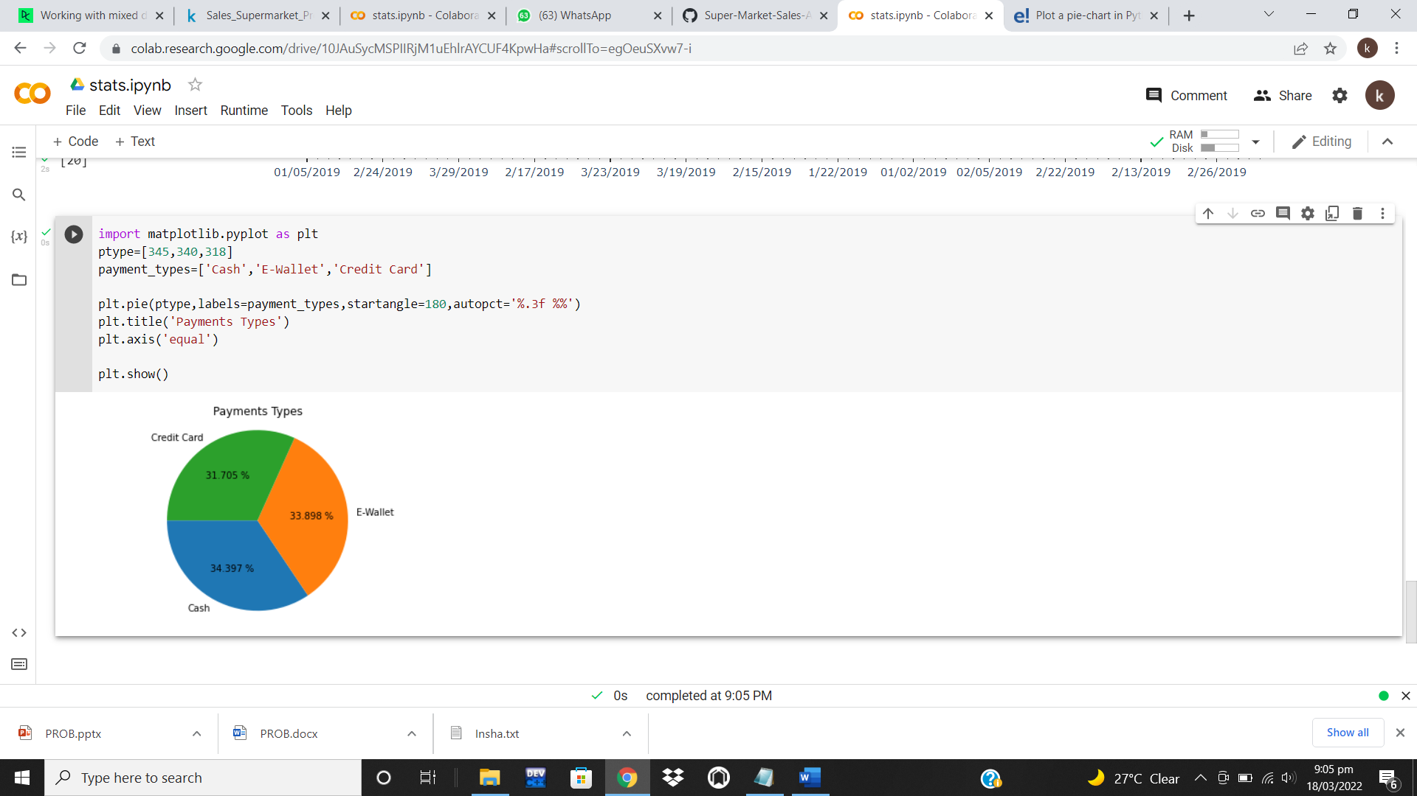
FACTOR 2 CONT..
PAYMENT TYPE CLASSIFICATION:
This pie chart statistical model is built
upon the modes of payments in the different
branches. It is based on the activity and
relationship the customers have with the Cash,
Credit card and E-wallets.
FIGURE 14: Payment Type Classification

Slide 46
GRAPHS AND TABLES SHOWING THE RESULTS
FACTOR 3: ENVIRONMENT OF CITIES AND BRANCHES INSIDE IT:
BRANCH WISE CLASSIFICATION:
The below graph shows the Invoice VS Branches.
It must be noted that BRANCH A have more
invoice number as compared to BRANCH B and C.
This means that there are a greater number of
customers in branch A. The environment of
branches causes great impact on lowering or enhancing
the number of customers.

Slide 47
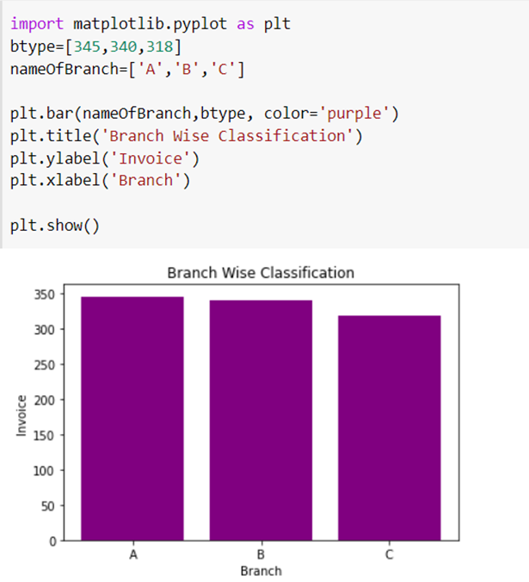
CONT..
The factors may include some SUPPLY LINES
(weather, cost of fuels, etc.), ECONOMIC FACTORS
(local and national economies, good and bad time,
rates at which necessities are provided), LAWS AND
GOVERNMENT (Increase in tax on products, restrictions
on purchases, etc.), etc. Positive factors will enhance
the number of customers whereas negative factors
will downturn them.
FIGURE 15: Branch Wise Classification

Slide 48
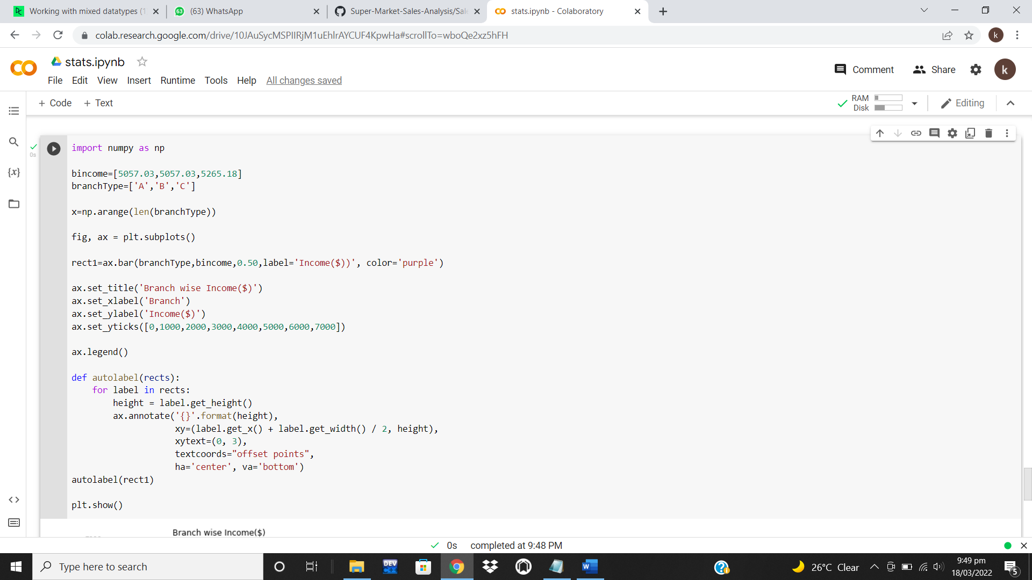
FACTOR 3 CONT..
BRANCH WISE INCOME/REVENUE:
As described regarding the number of customers,
we don’t know that which customer shops for how
much. Here a question arises that how the BRANCH C
shown have greater income over all three branches,
even if it had a smaller number of customers? It
depends upon the need of customers that impacts
on how many products they are buying.
FIGURE 16: Branch Wise Income/Revenue

Slide 49
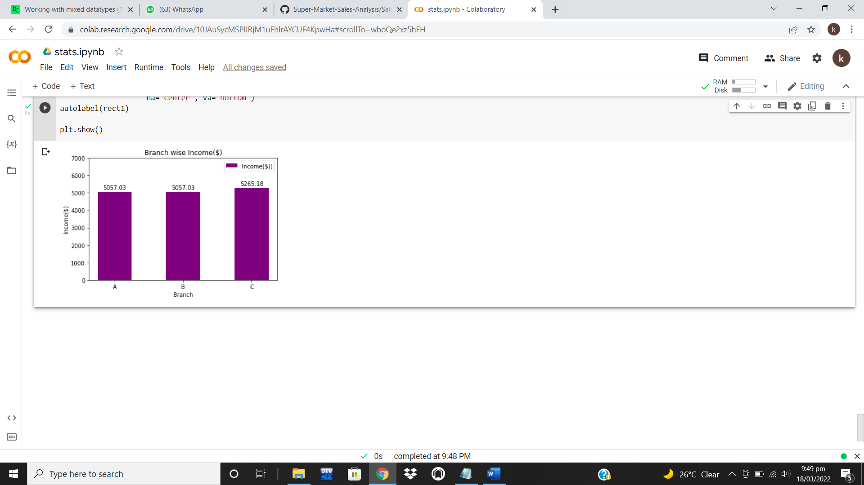
CONT..
FIGURE 16.1: Branch Wise Income/Revenue

Slide 50
FACTOR 3 CONT..
PRODUCT SALES OF DIFFERENT BRANCHES:
Needs of customers are the basic factor behind
the sales of a market. Different customers have
different needs and so desire to buy different
categories of products. The well-known categories
must be provided by the market to increase
their sales.

Slide 51
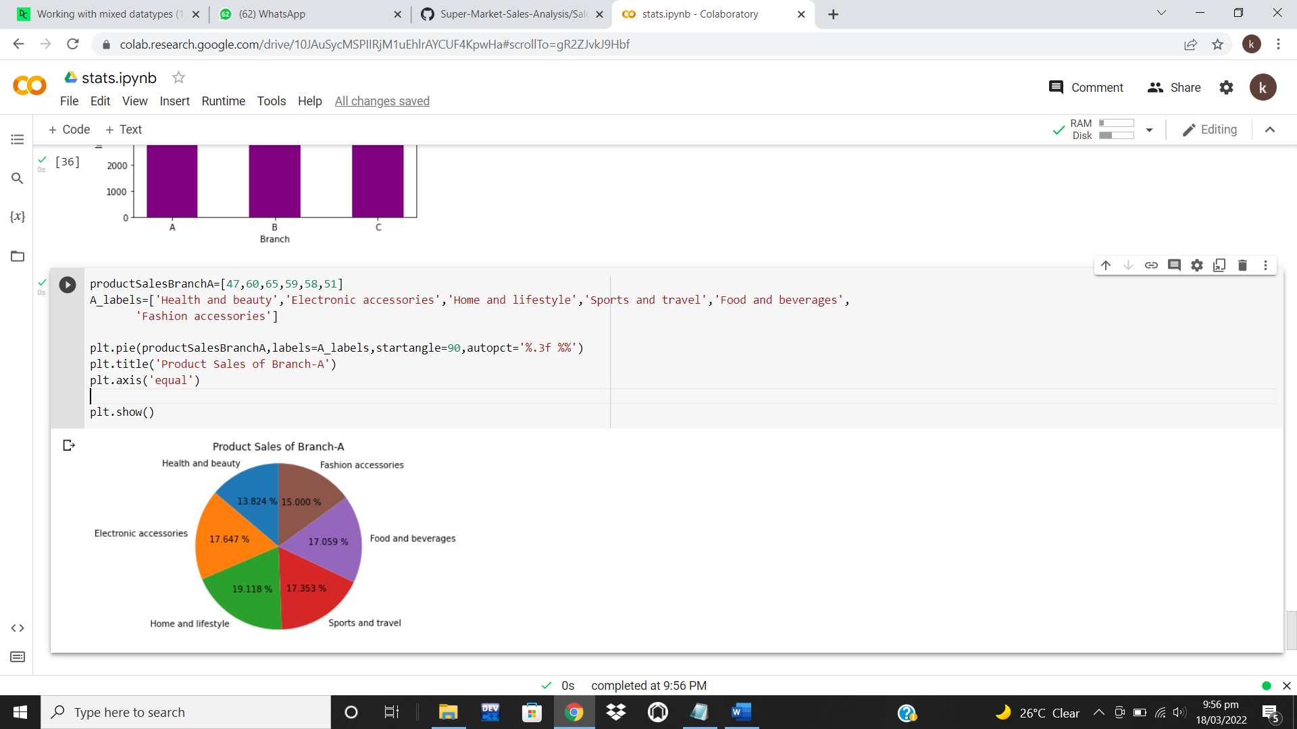
CONT..
BRANCH A:
The 1st branch buys more home and
lifestyle products. Fashion accessories are the
exceptional option for them. Rest of the categories
appears as their common need. The markets in
this city must be well-aware regarding the needs
of their customers to attract them to promote
their sales.
FIGURE 17: Product Sales of Branch A

Slide 52
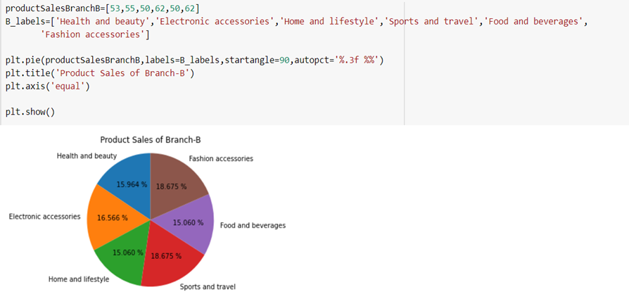
CONT..
BRANCH B:
The 2nd branch buys more sports, travel,
and fashion accessories products. Home and lifestyle
products are their exceptional option for them. Rest
of the categories appears as their common need.
The markets in this city must be well-aware regarding
the needs of their customers to attract them to promote
their sales.
FIGURE 17.1: Product Sales of Branch B

Slide 53
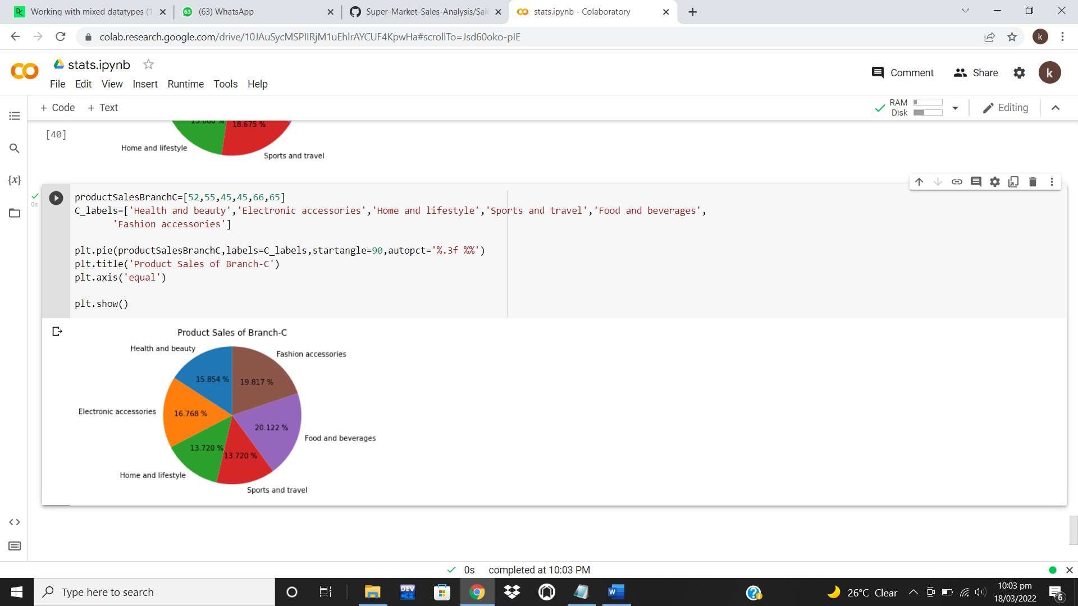
CONT..
BRANCH C:
The 3rd branch buys more food and beverages
products. Sports, travel, home and lifestyle
products are their exceptional option for them.
Rest of the categories appears as their common
need. The markets in this city must be well-aware
regarding the needs of their customers to attract
them to promote their sales.
FIGURE 17.2: Product Sales of Branch C

Slide 54
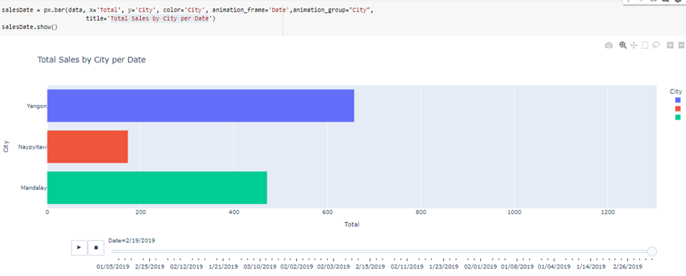
FACTOR 3 CONT..
TOTAL SALES BY CITIES PER DAY:
(only visualization because data visualization each cell
represents that): In mixture of all above mentioned
factors and needs affecting the customer grocery
and shopping’s, below is the total sales by cities
per day.
FIGURE 18: Total Sales by Cities Per Day

Slide 55
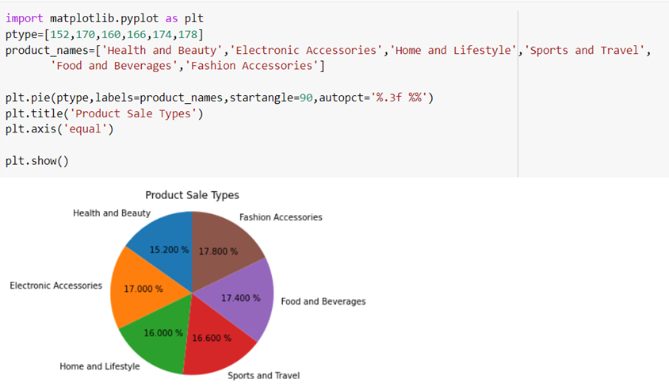
GRAPHS AND TABLES SHOWING THE RESULTS
FACTOR 4: TYPES OF PRODUCTS AND THEIR COSTS:
PRODUCT WISE CLASSIFICATION:
Customers will not have the same attitude and
behavior towards all the products category as the
products differ based on degree of product
involvement and the degree of differences in
brand, which allows the consumers to select from
a wide variety of diversified products and allowing
the supermarket owners to focus on the areas to expand
where customer flux is high.
FIGURE 19: Product Wise Classification

Slide 56
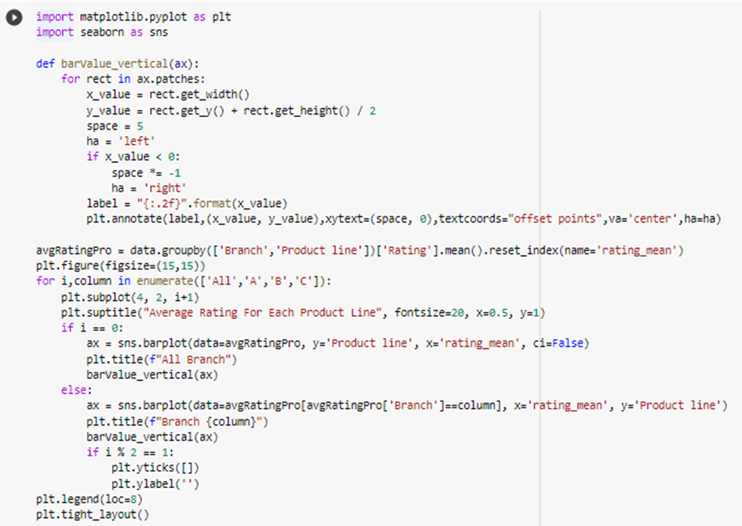
FACTOR 4 CONT..
AVERAGE RATING FOR EACH PRODUCT:
Average rating is highly volatile early on
but tends to stabilize after more reviews are
collected. It basically monitors your average ratings,
but also considers how many reviews the product
has received, which gives a meaningful perspective
on consumer sentiment. It also helps the sellers to
provide a content on a winning product-even if
the rating has stabilized.
FIGURE 20: Average Rating for Each Product

Slide 57
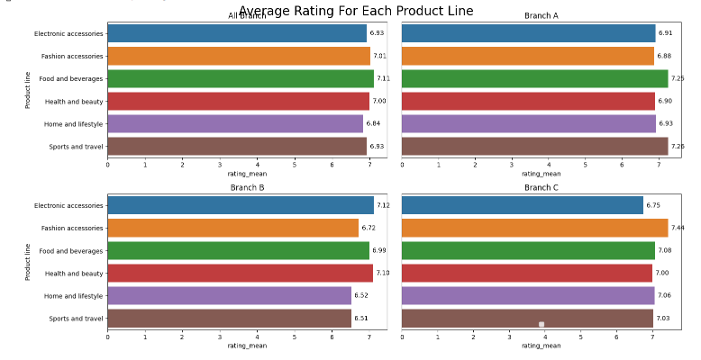
CONT..
FIGURE 20.1: Average Rating for Each Product

Slide 58
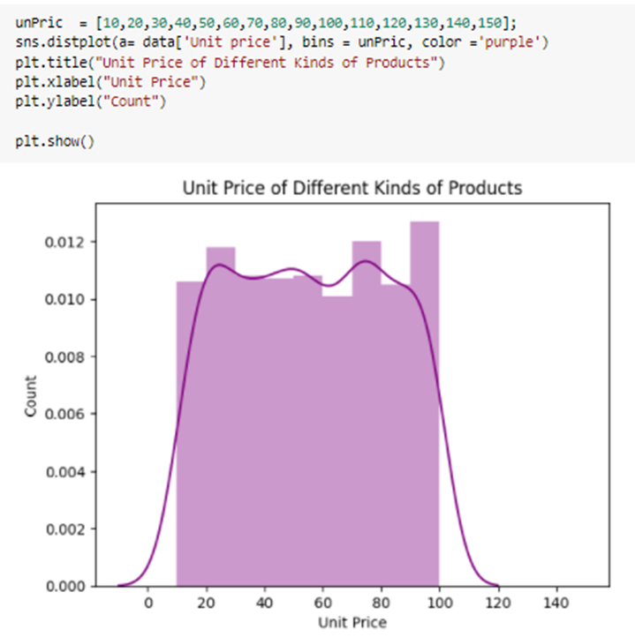
FACTOR 4 CONT..
UNIT PRICE OF DIFFERENT KINDS OF PRODUCTS
(unit prices fluctuation as well as ranges):
It allows you to compare the goods. Customers
and owners both can easily compare which
product is more convenient to them, allowing
them to explore the same products in different
packages, sizes, forms, or configurations.
FIGURE 21: Unit Price of Different Kind of Products

Slide 59
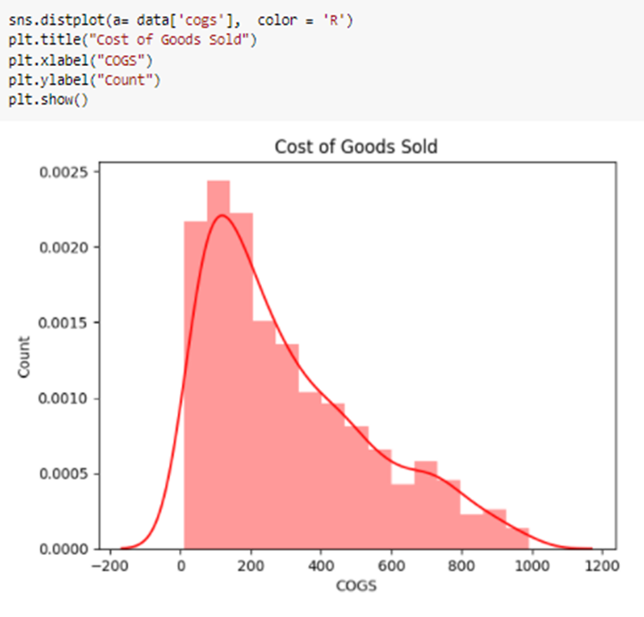
FACTOR 4 CONT..
COST OF GOODS SOLD:
Cost of goods sold is the carrying value
of goods sold during a particular goods
during the period, helping the supermarket
for restock and to estimate the expiration
period of the items stocked.
FIGURE 22: Cost of Goods Sold

Slide 60
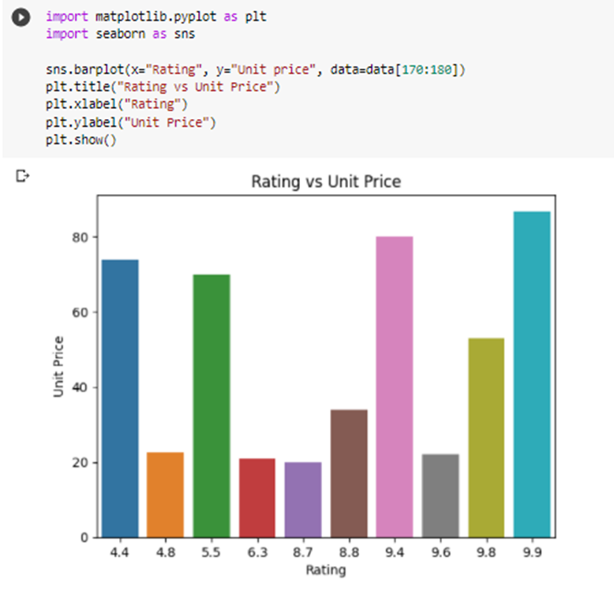
FACTOR 4 CONT..
RATINGS VS UNIT PRICE:
Determining the price quoted in terms so
much per agrees or estimating the standard
product service fee ranging in the customer’s
view. Basically, it is the customer’s views on
pricing of the products which help the
supermarket to raise the products of that
pricing for better valuations and sales.
FIGURE 23: Ratings VS Unit Price

Slide 61
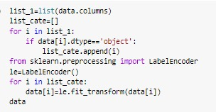
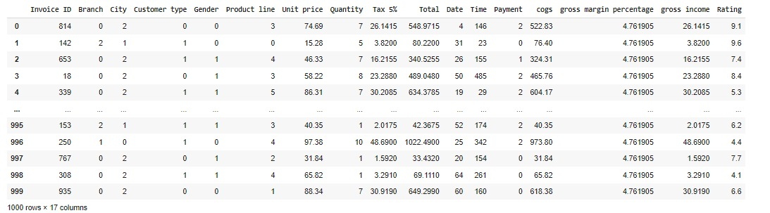
CONVERTING AND TRAINING DATA
To train our model for regression, we convert the nominal data into categorical data for order or sequence. We create a new variable, against each value either in binary, dummy for different disciplines that attempts to determine the strength and character of the relationship. After building this, we just printed the new converted data.
FIGURE 24: Converting and Training Data

Slide 62
KNEIGHBORS CLASSIFIER - REGRESSION
The K-Nearest Neighbors Algorithm is a supervised learning algorithm that can be used to solve both the classification and regression problems. It assumes that similar things exist in proximity or maybe like similar things are near to each other. Here for instance the algorithm is working on the Genders coming to the supermarket to hinges on the assumption being true enough to satisfy all the correct outcomes.

Slide 63
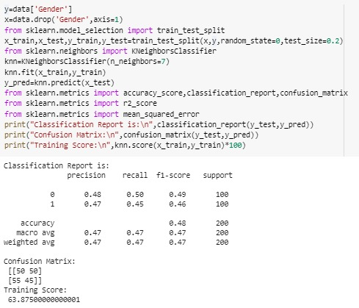
CONT..
Like the rating given by some specific gender will be this, these gender will might possibly behave in this fashion on a random based variable given. The idea basically is to capture the concept of similarity with some distancing relationships and Euclidean formulae. Precision to the estimation is recorded in general.
FIGURE 25: Kneighbors Classifier

Slide 64
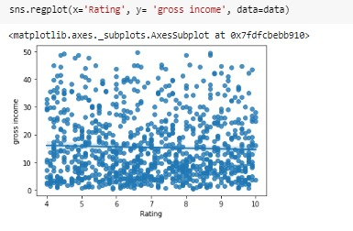
PREDICTING GROSS INCOME VS RATING (Linear Regression Model)
When rating is plotted against the gross income to know the linear regression model i.e., knowing the prediction of the gross income coming from different products according to their ratings, where the linear line is representing the model fit.
FIGURE 26: Prediction of Gross Income VS Rating

Slide 65
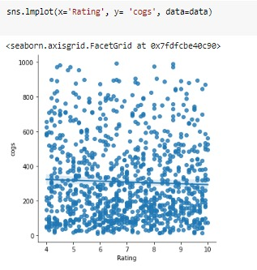
PREDICTING COGS VS RATING (Linear Regression Model)
The COGS vs rating predicted ratio in lmplot showcases the linear regression model of best rated products revenue estimation (up to the precision according to the values) that is used for expenditures, gross income and sales unit balancing that vary directly with the sales of your business.
FIGURE 27: Prediction of COGS vs Rating

Slide 66
CONCLUSION:
The tools and methods developed for this study
have proven valuable. For over 12 weeks,
spanning three different chains of same store,
different data collections on different attributes
have taken in an efficient and accurate manner.
The tools that were found to be most helpful was
a Gross income, Gross Margin Percentage, COGS.
Payment, time, dates, etc.

Slide 67

CONT..
These variables were used for predictive data
analytics purpose and data visualization on
different case studies. These studies can help
the new business investors and retailers to know
the collective mind of peoples visiting the
stores that which area is the best, life shell of
products, etc.
FIGURE 28: Conclusion

Slide 68
REFERENCES
Clients:
https://www.sba.gov/blog/10-ways-get-new-customers
https://zoovu.com/blog/women-vs-men-gender-differences-in-purchase-decision-making/
https://www.rapyd.net/blog/local-payment-methods/

Slide 69
CONT..
Environment of Cities and Branches Inside it:
https://yourbusiness.azcentral.com/environmental-factors-affect-marketing-decisions-22203.html
Types of Products and their Costs:
https://www.researchgate.net/figure/Product-wise-classification-of-preferred-mode-of-purchase_tbl1_342866190

Slide 70
CONT..
Modes of Payment:
https://en.wikipedia.org/wiki/Unit_price
Average Rating for Each Product & Rating Vs Unit Price:
https://www.bazaarvoice.com/blog/many-reviews-take-achieve-meaningful-average-rating/
https://www.merriam-webster.com/dictionary/unit%20price

Slide 71


